Slide 1
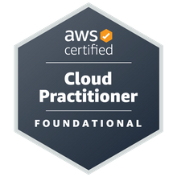
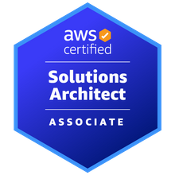
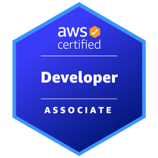
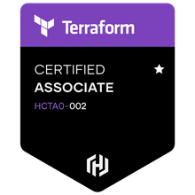


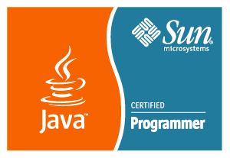

LinkedIn: www.linkedin.com/in/mchugh44
Git: https://github.com/mayankchugh1977
Mayank Chugh
Skills
Project lifecycle management; Project manager supervision; Architecture Change Management; Migration Planning; Release management; Technical project planning; Project requirements analysis; Build technical teams; Technical documentation understanding; Solution Technical architecture (Application + Cloud); Security Designs/Patterns; Project scheduling and budgeting; Custom software development and database design; System migration/integration; Quality assurance
Cloud Services: AWS; DevOps: GIT, Jenkins pipeline, AWS CI/CD pipeline, Ansible, Containers, K8S, Terraform; Languages: Java / J2EE, EJB, Spring Boot, JavaScript, Struts 1.x MVC, Python; Databases: Oracle, MySql; Reporting tools: iReport, Jasper Report; Version Control: GIT, SVN, VSS; Web Services: SOAP, Rest API Development; Management Tool: JIRA, Confluence; Maximo, Bugzilla; Machine Learning: Supervised Learning – Linear/Logistic Regression, Decision Tree, Random Forrest Tree; Operating Systems: Windows (XP, 10), Lunix and Ubuntu; Methodologies: Agile, Waterfall Model
Relevant Experience
Client: CHANEL
Participated in Pre-sales activity for providing High availability, Fault tolerant and resilience application to the client.
Contributing as SME for application implementation and Azure cloud for accepted SLA, RPO and RTO.
Working closely with delivery head, fellow Architects and other members for delivering complete IT solutions.
Client: HSBC
Gathered project requirements for setting up application on Cloud through interactions, meetings, and walkthroughs with potential application users functional and non-functional requirements.
Server side API designing, Security Patterns designs decision and Providing AWS architecture for setting up AWS EKS cluster having Jenkins CI/CD pipeline.
Client: Cathay Pacific Cargo Terminal & Asia Airfreight Terminal
Gathered project requirements (150+ of AAT and 35+ of CPSL) through interactions, meetings, and walkthroughs with potential application users to develop/design business requirements documents (BRD). Also, I created 55+ technical responses to Requests for Quotes (RFQs) for customers.
Successfully managed multimillion-dollar revenue accounts including focus on several Completed 15.5K days of works. I have managing releases during all phases of software development life cycle, from requirements analysis through system implementation for more than 2 enterprises projects. Worked closely with customers, internal staff and other stakeholders to determine planning, implementation and integration of system-oriented projects. System development of RESTful API for having interface with HKIA.

Slide 2
Projects & POCs
WebLogic to Jboss and Oracle to MySQL Migration – Monolithic Application Migration to AWS Cloud
On Premises Application Migration to AWS - POC
As part requirement client want to migrate application. We would need prepare quicker roadmap to best optimal ways for migration for Monolithic application to AWS Cloud with all possible options. As a vendor, we have migrated basic framework and one of module of existing from Weblogic application Server to Jboss Server. Also, We have done all required changes for migrating Oracle database to Mysql/Aurora database.
Skills and Tools – RedHat Jboss migration tool, Jboss The AWS Schema Conversion Tool (AWS SCT)
Mobile Apps Development for Cargo Users – Development and Magnificence for iOS and Android Application
Hybrid Cloud Management – combination of Public and Private cloud
Provide cost optimization solution, Business, information and technology architecture and maintenance support to client for their new Mobile apps and upgrades Mobile Apps. To handle complex business functionality of Transhipment and intermodal functionalities. Application should allowed the agents, truck drivers and carrier airlines to view schedule and status of flights so that the shipment can be planned for delivery and pick-up. This app enabled user to track the status of Export/Import/Transhipment shipments. It also provid notifications to the user when the Import shipment is ready for pickup so that user can plan and schedule the travel to Cargo Terminal to pick-up the same. It reduced the customer support effort of Cargo Terminal Operator by self-servicing of flight schedule/AWB Enquiry and Notification. It also allowed users to choose languages of choice.
Skills and Tools – J2EE, Oracle, App Notification and Google Notification

Slide 3
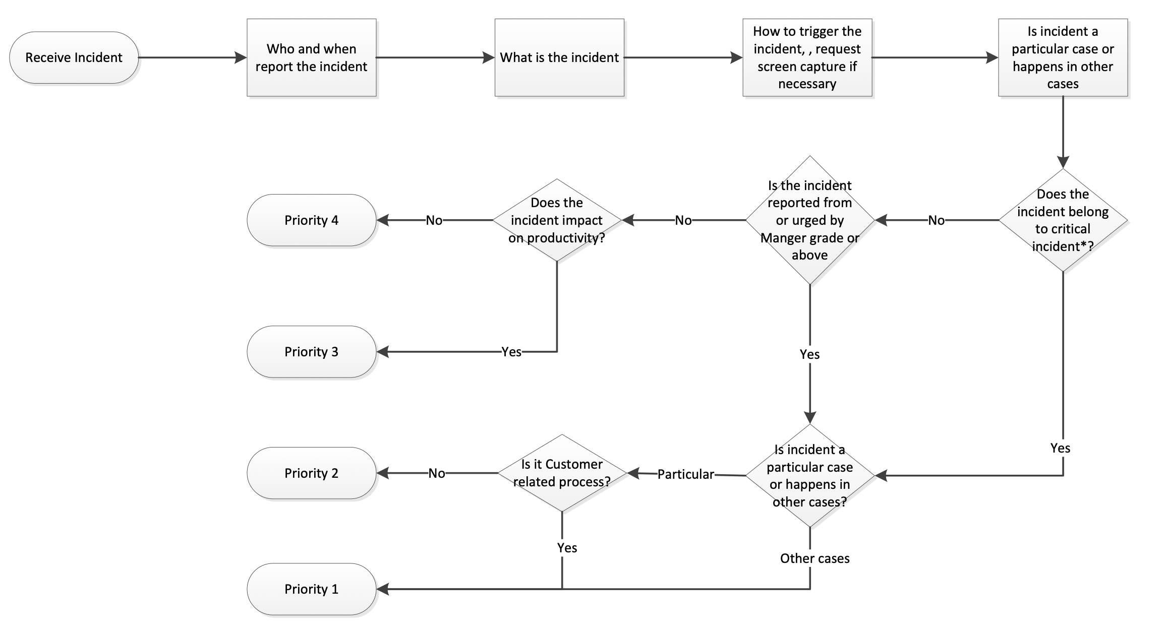
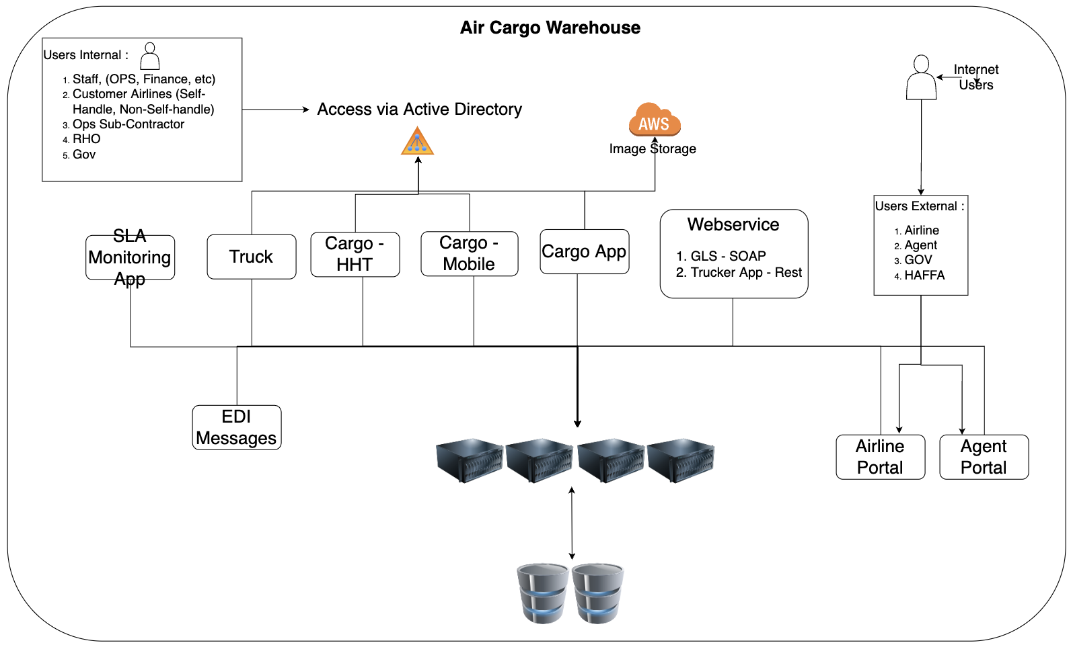
Cargo Application – Support and Maintenance
Incident Management Process (SLA Adherence)
High Level Architecture

Slide 4
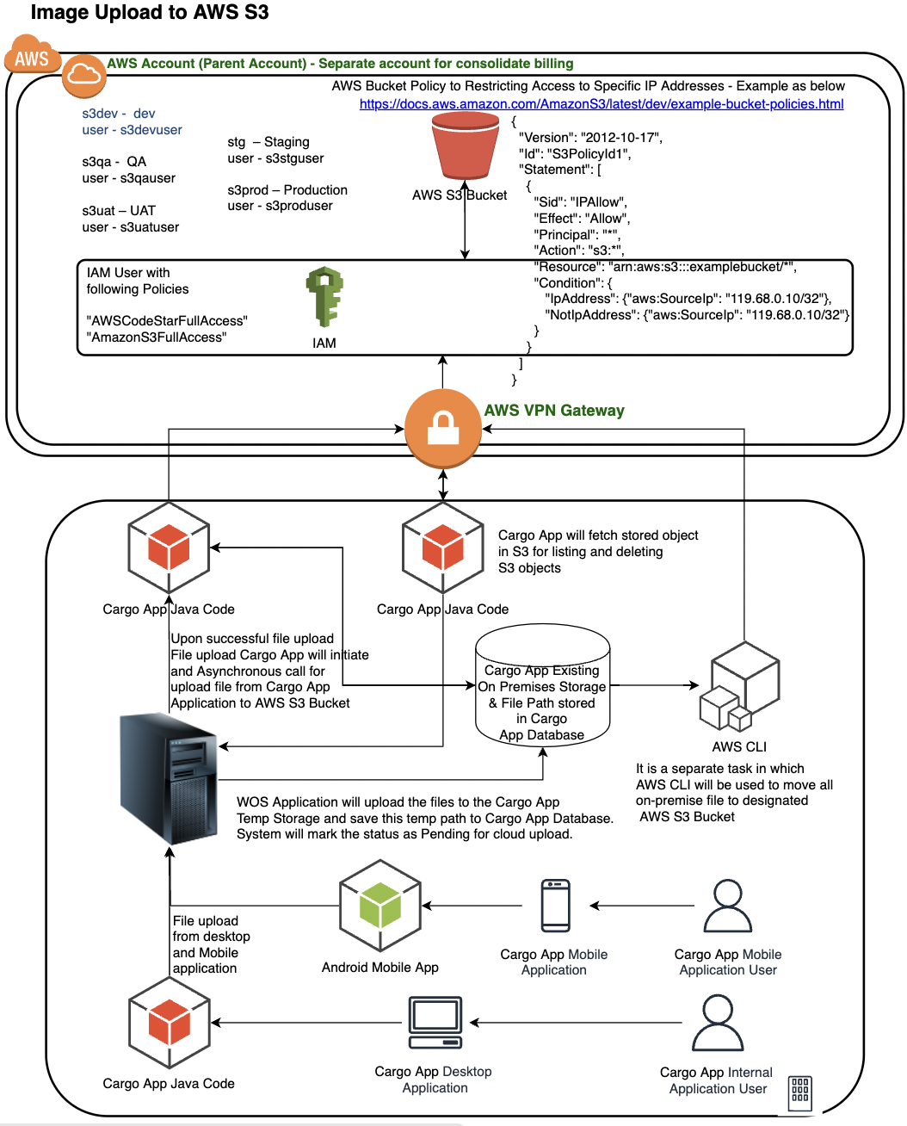
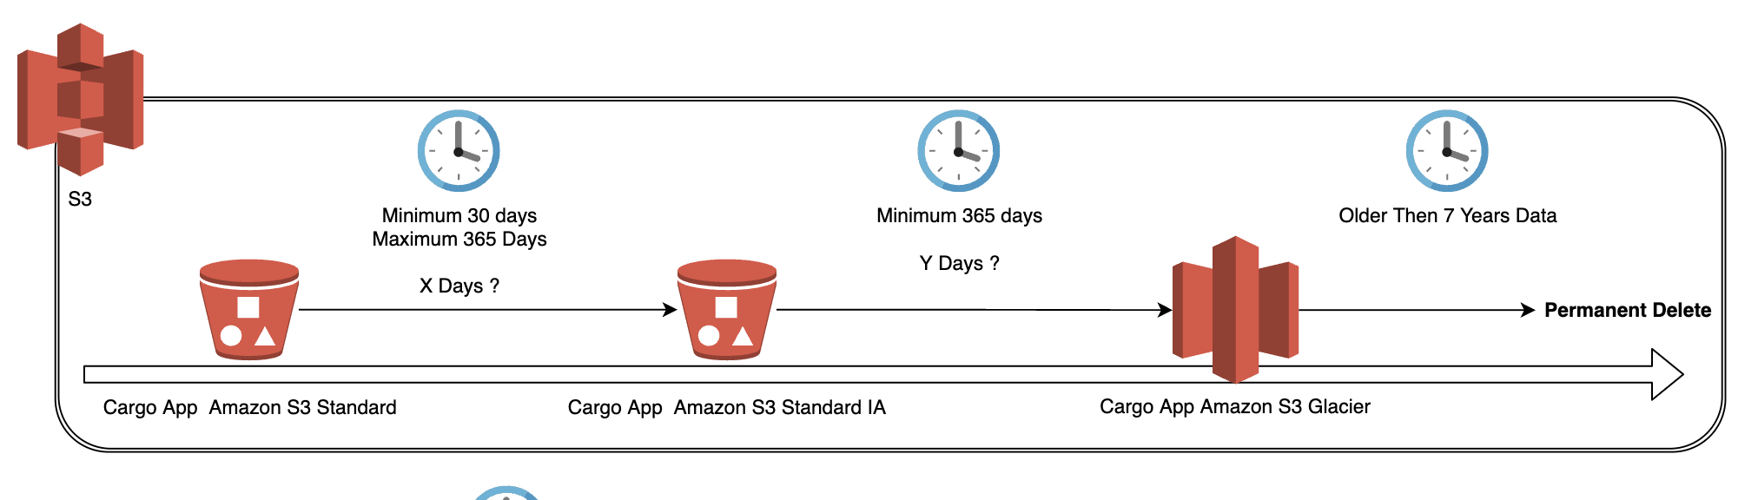
CR for Image Upload to Cloud and Archival Lifecycle on Cloud
Storage S3, CLI - Cloud Computing on AWS
On Premises File Storage to AWS S3:
Provides fault tolerant, highly available design → development → deployment → monitoring → maintenance → data analytics support for file upload Migration from on-prem files storage to AWS S3 bucket logic. In-addition, This enhancement provides the capability to upload the image, document, video and store the files in AWS S3 Bucket instead of on prem storage.
Skills and Tools - S3, AWS SDK (Java), awscli

Slide 5
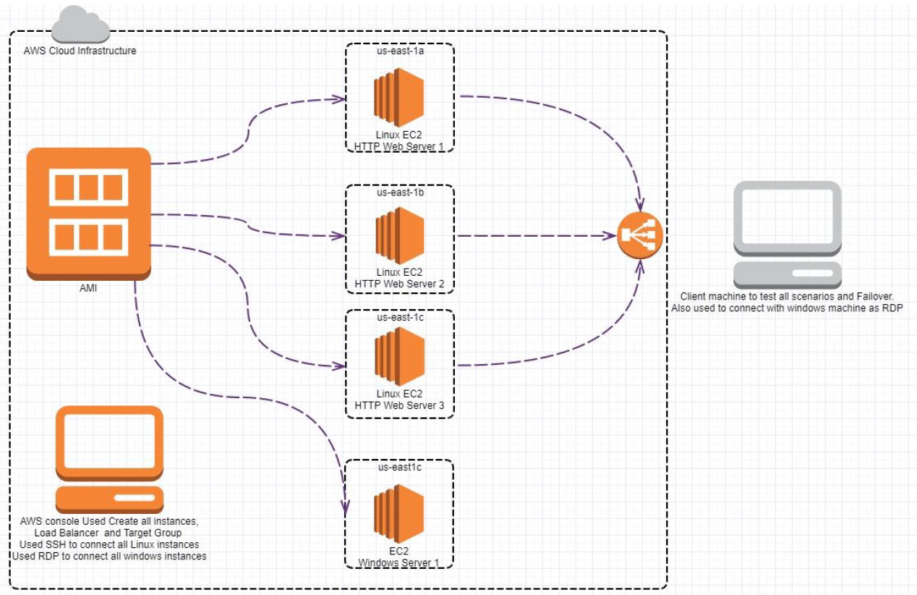
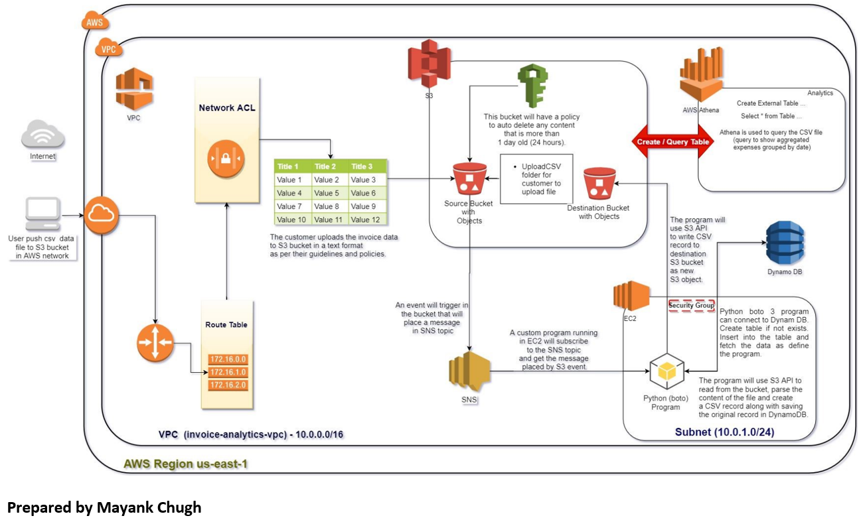
Cloud POCs
EC2 | Multi AZ Deployment | Load Balancing Deploy multiple EC2 instances in different AZs and experiment with load balancing, target groups and understand the impact of instance failure | Creating a file share & sync solution using ownCloud and AWS: Scenario -Solving the Dropbox Problem; These files, containing sensitive company and customer data, are stored in a public cloud outside of the businesses' control -possibly even outside of the country. The potential for data leakage and security breaches is enormous and companies need to stay compliant with their own policies and procedures for security and governance Skills and Tools - Amazon EC2, Load Balancer | Building an Automated Business Process using Managed Services on a Public Cloud In the connected world, it is imperative that the organizations be interlinked with the customers and vendors. This process has been very sluggish, manual, batch-based and prone to failures. Such Integration design has lead to impaired decision making and delays in the detection of fraudulent actions. This project created an automated, event-based real-time process using managed cloud services that do not have these limitations. Services & Concepts - VPC, IAM, EC2, Athena, SQL, Programming etc. Skills and Tools - Athena, Dynamo DB, S3, SNS

Slide 6
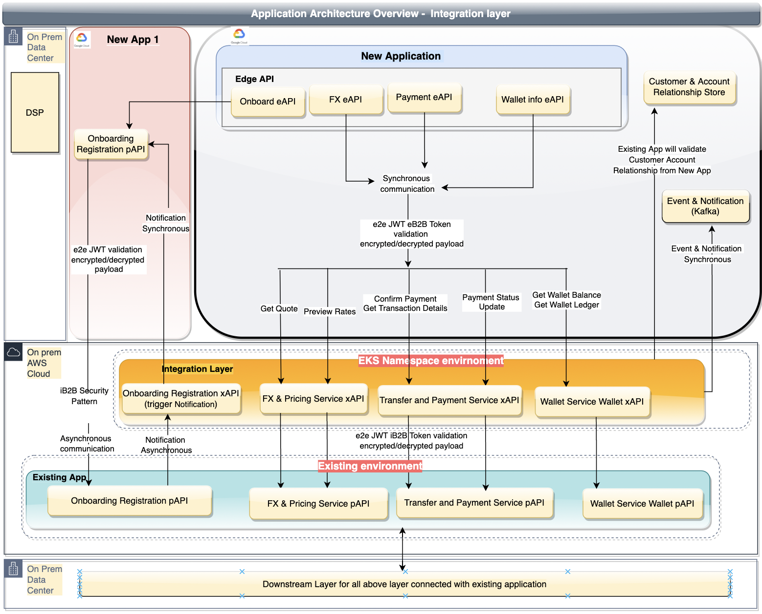
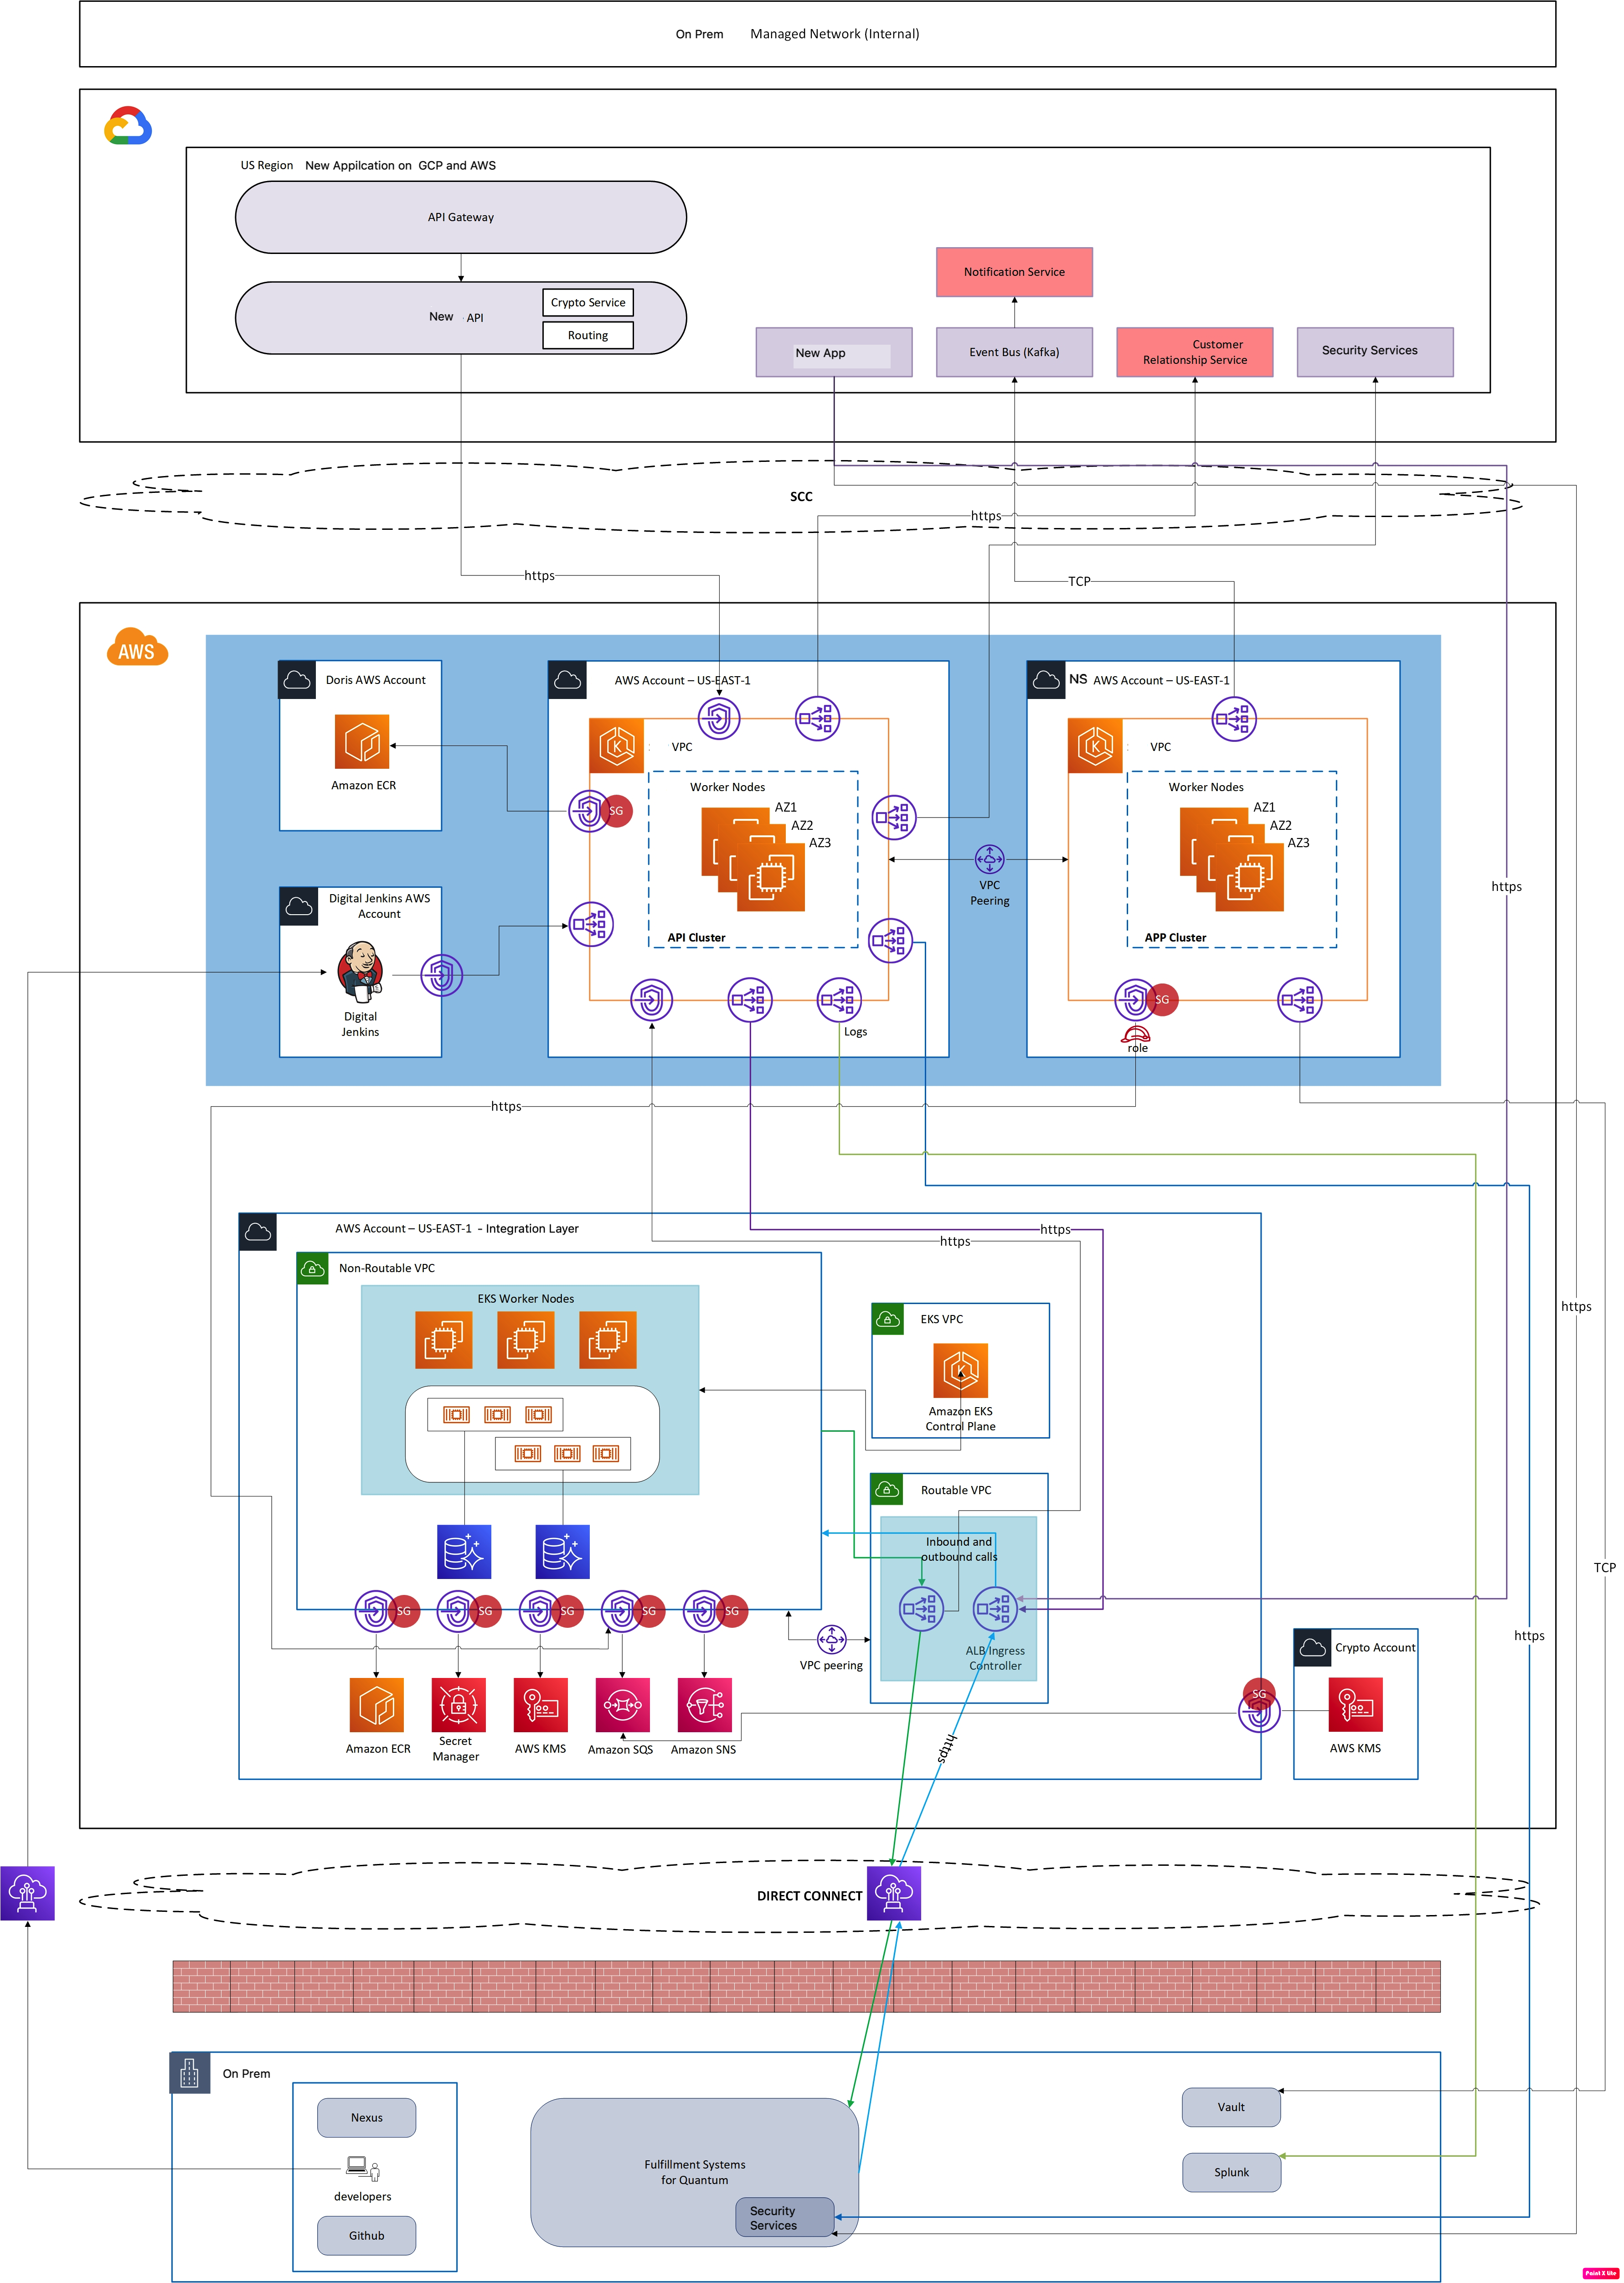
Integration Layer
Application Architecture Design
Infrastructure Architecture Design
API Integration layer
This is an enhancement to New Application, the Old platform. Partners users will onboard by using New application system & system will use the digital wallet service provided by Old Application. So we have introducing new Integration Layer introduces a thin API layer on top of existing Old Application services which would validate the API requests from new application & execute underlying Old application services. AWS EKS Namespace (useast-1) platform would be use for deployment and host APIs.

Slide 7
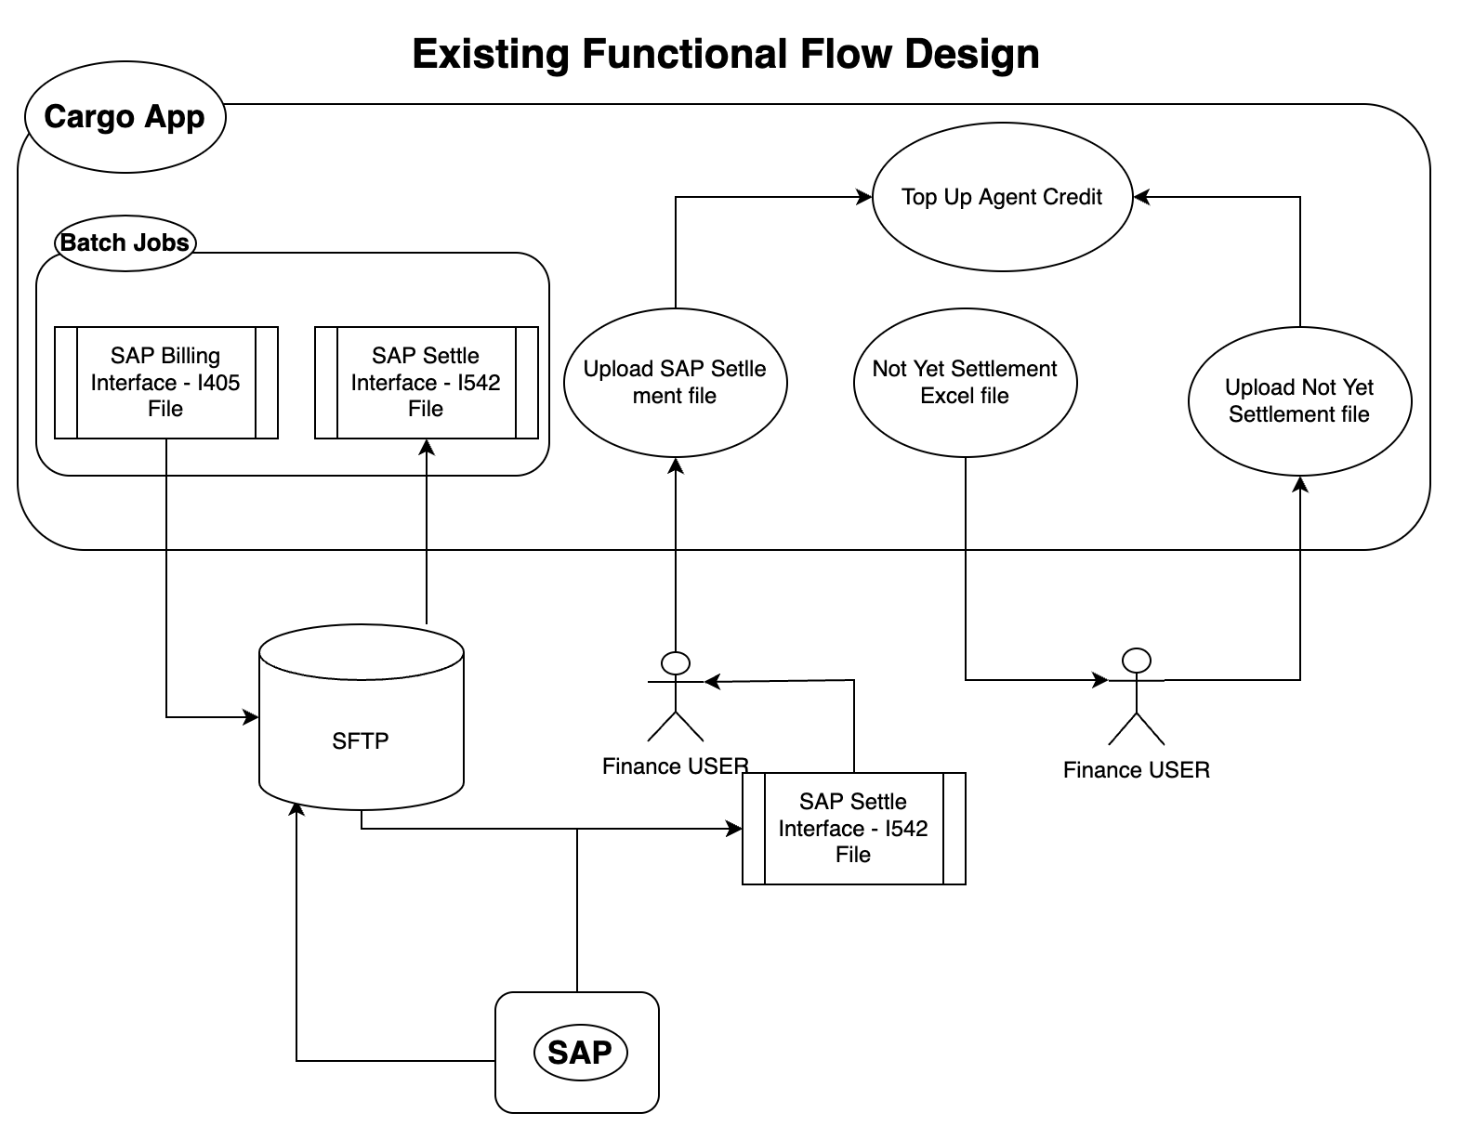
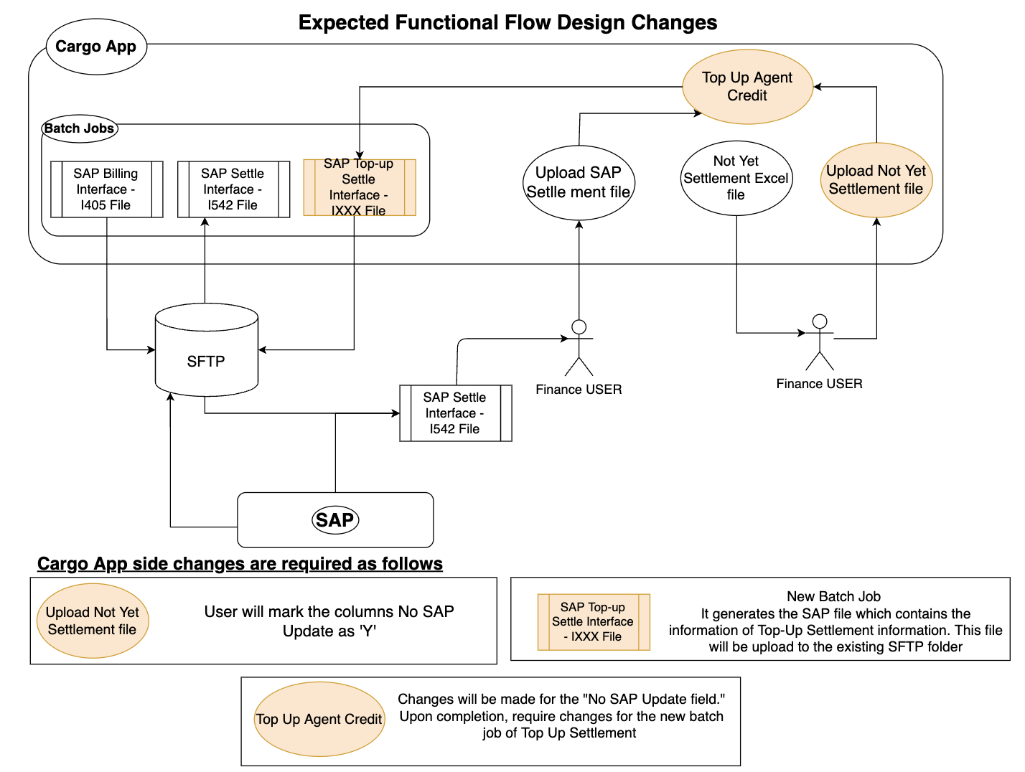
Functional Change Request Design - Example

Slide 8
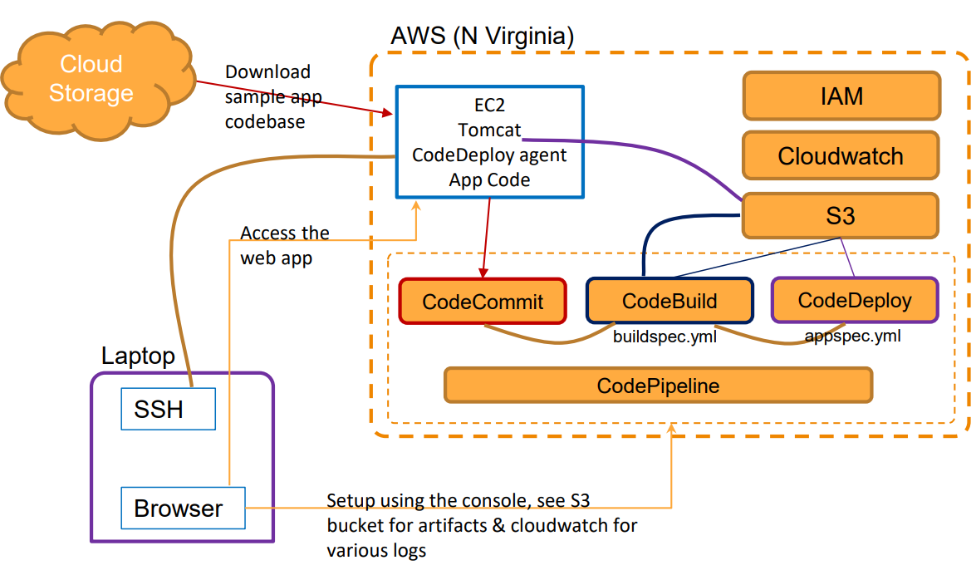
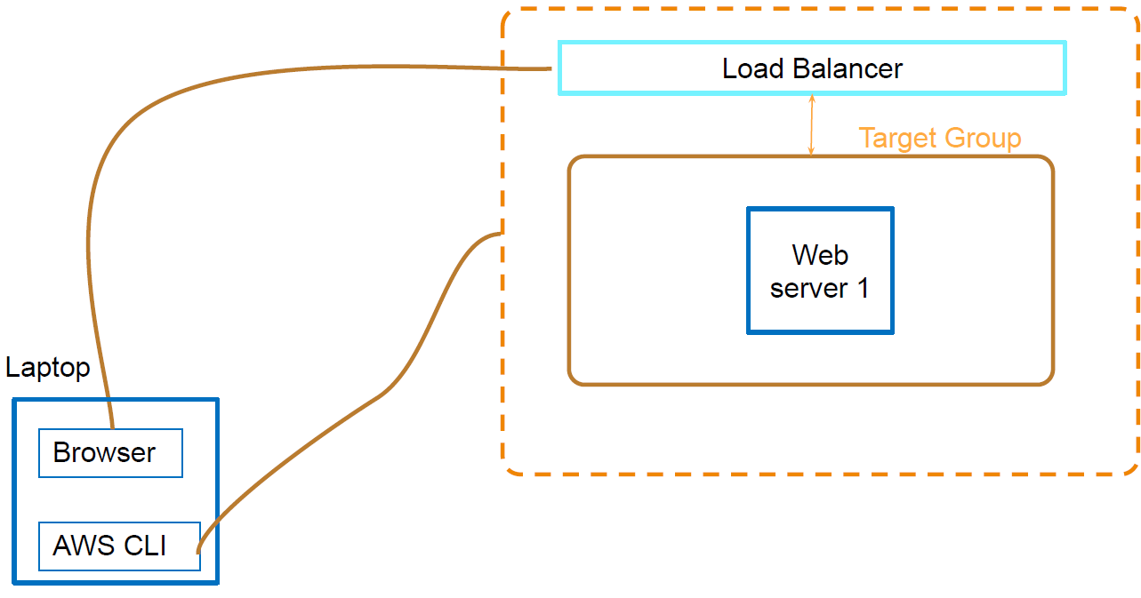
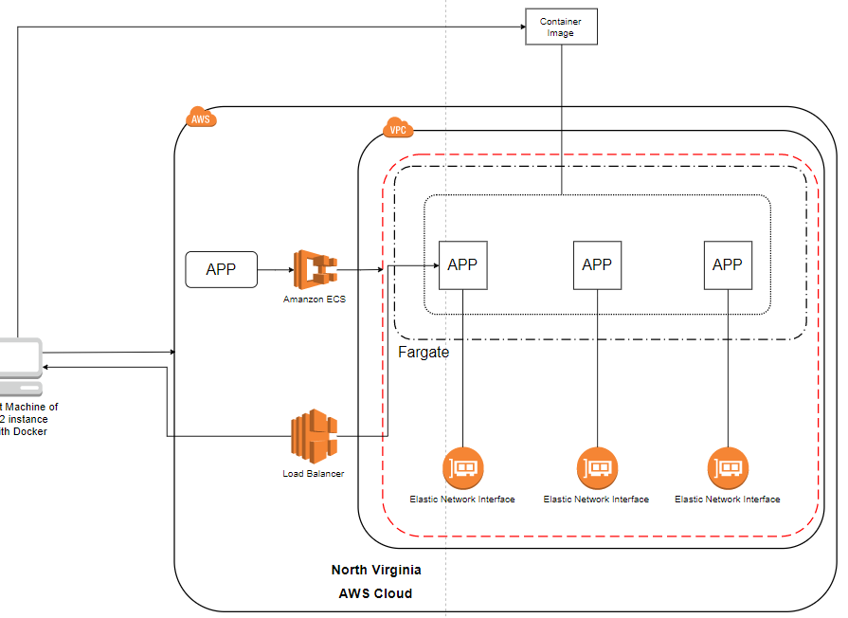
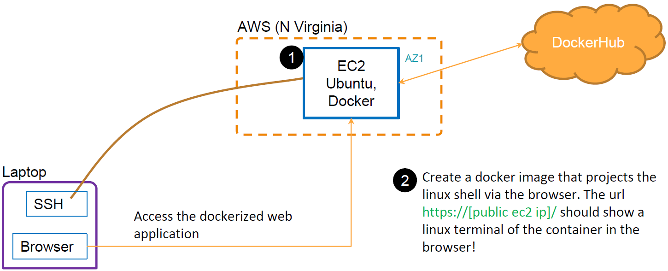
Architecture Designs
DevOps CI/CD | Code Pipeline | Automation - AWS CloudFormation; AWS CLI
Container and Microservices Docker | Images, containers, scripts | Deploying a web application to ECS

Slide 9
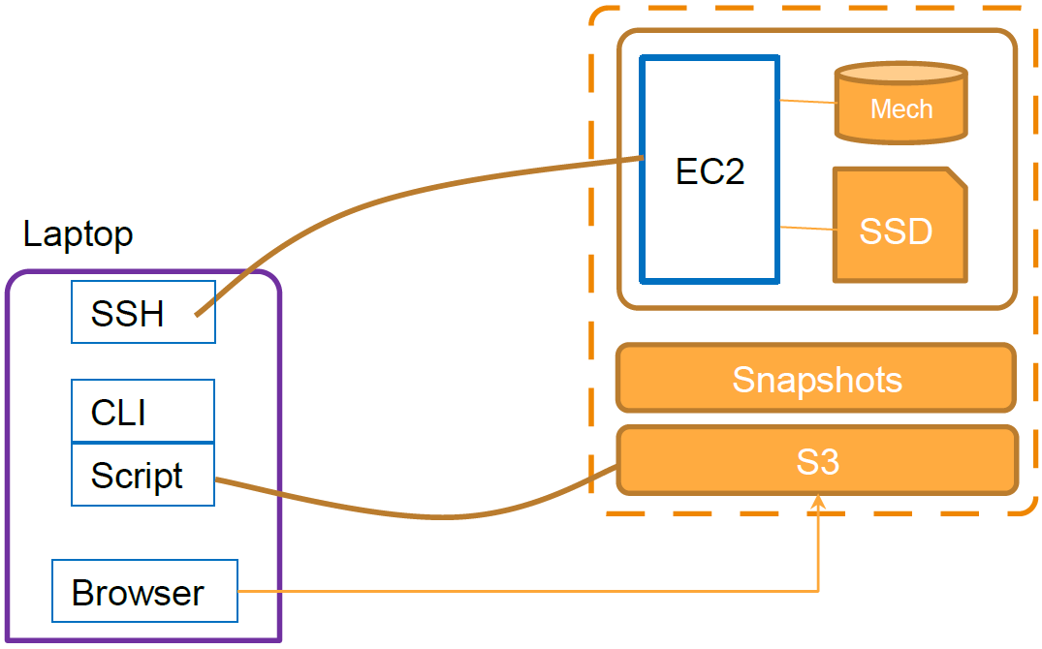
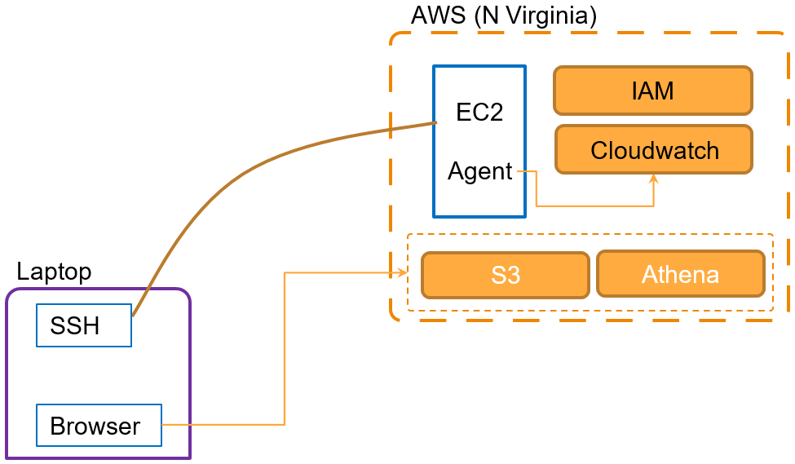
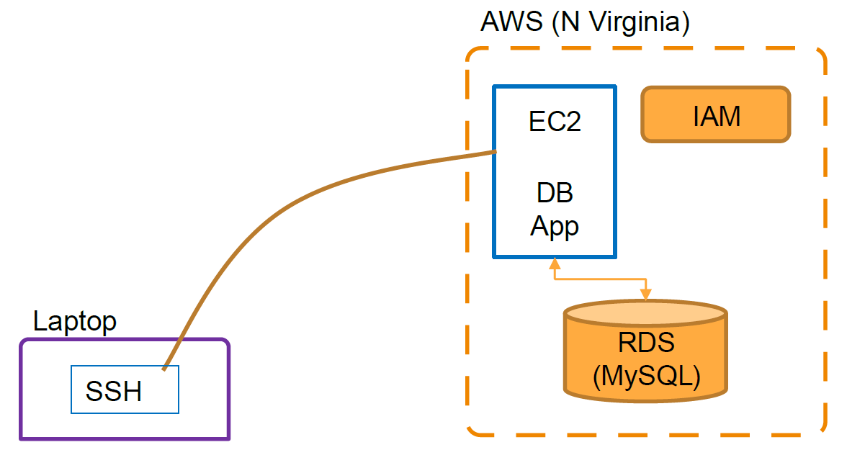
Architecture Designs
EC2 | Multi AZ Deployment | Load Balancing | Storage | Volumes, S3, CLI | Log aggregation| Quick data analysis
Creating a file share & sync solution using ownCloud and AWS | RDS | EC2 database program | Building an Automated Business Process using Managed Services on a Public Cloud

Slide 10
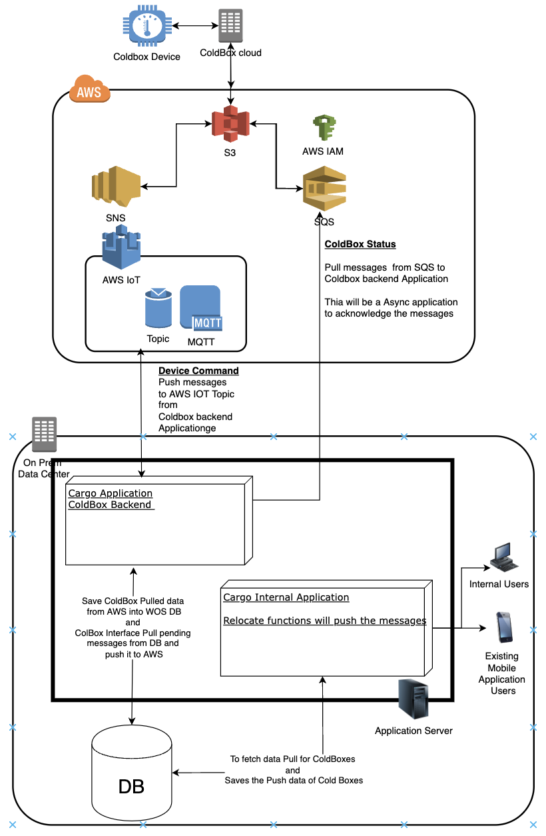
ColdBox Implementation

